Slide 1

Advanced Analytics with Azure DevOps Dojo
11.05.2023 | Azure Bootcamp Switzerland 2023 | Arindam Mitra & Adrian Senn

Slide 2

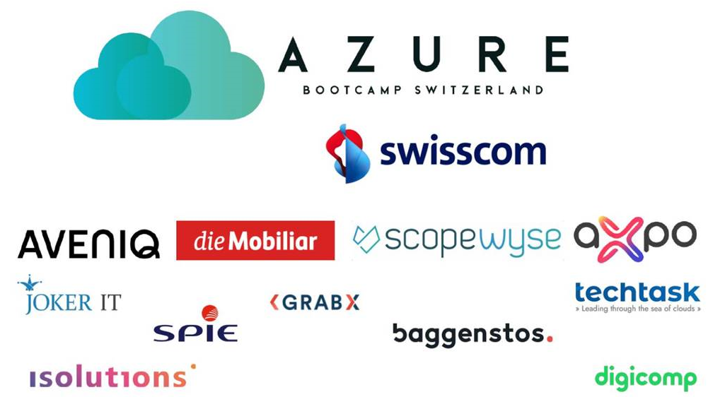
SESSION ABSTRACT:-
In this session, we would like to share with you, our insights of running Data Science and Machine Learning use cases on Azure Analytics Platform within the business area of Trading & Sales at Axpo. As those use cases are running 24/7, we are striving to write robust and production-ready code, allowing us to react fast and meaningful, based on the most recent market changes.
Hence, we are relying heavily on Azure DevOps CI/CD for managing our codebase and deployment pipelines. Together with Cloud Platform Team, we have built a comprehensive set of automated DevOps processes, helping us to reduce the time to market of new ideas and scaling DevOps best practices with the entire organization.

Slide 3

SPEAKER INTRODUCTION:-
I am Arindam Mitra | Microsoft MVP in Developer Technologies | Azure Cloud Solutions & DevOps Architect | Technical Blogger | Speaker | Traveler | Citizen of the World
I work at Axpo as Senior IT Infrastructure Specialist.
You can look me at:
https://github.com/arindam0310018
https://dev.to/arindam0310018
https://sessionize.com/arindam0310018
https://www.linkedin.com/in/arindam-mitra-28981095/
https://twitter.com/arindam0310018
https://mvp.microsoft.com/en-us/PublicProfile/5005235?fullName=Arindam%20Mitra

Slide 4
SPEAKER INTRODUCTION:-
I am Adrian Senn | Studied Quant. Finance and Economics | Innovative | Ambitious | Team Player | Stay full of energy by eating swiss chocolates
I work at Axpo as Senior Machine Learning Engineer.
You can look me at:
https://www.alpinsolar.ch/content/axpo19/ch/en/about-us/lightboxes/adrian-senn.html

Slide 5
AGENDA:-
Our Business Areas
Trading and Sales
Portfolio
Why Advanced Analytics ?
Make a guess ?
Physical power trading: Intraday
Ideas in a complex world
Analytics at Axpo
Current Models: Facts and Figures
Platform Design
Azure Architecture
Devops in Advanced Analytics
Pipeline Templates
Multiple Environment – Replace Token
Devops SSH with Terraform Modules
How we Onboard Usecase ?
Demo Workflow
Gratitude

Slide 6



OUR BUSINESS AREAS:-
Generation & Distribution
Hydro and nuclear
Wind
Photovoltaic
Distribution
Trading & Sales
Asset backed trading
Proprietary trading
International Origination
CKW
Power generation
Building technologies
Distribution
PV Switzerland

Slide 7
Leveraging volatility and optionality
TRADING & SALES:-
Fundamental understanding
of the market
Relationship, trust and understanding relationship customer and managing risk exposure
Asset-backed trading
Optimise the return on the asset.
Trading both position and optionality of physical assets.
Proprietary trading
Based on a market view where the trader can take both long and short positions in energy commodities.
Fundamental analysis to identify and investigate market inefficiencies.
Origination & customer solutions
Standard and tailored contracts with customers.
Structured transactions, sales, contracts (e.g., full supply, portfolio management services).
Retailing.
© Axpo,

Slide 8
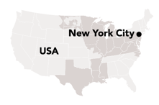
PORTFOLIO:-
11
23
Oslo
Helsinki
Axpo has accumulated 80 TWh of PPAs in its portfolio.
Axpo manages wind energy, photovoltaics, biomass and hydro power.
Axpo markets a large portfolio of producers of renewable energy, with over 80 TWh under contract.
Main contributor is Axpo Nordics with a wind portfolio of over 23 TWh.
19
Malmö
1
2
London
Amsterdam
Warsaw
2
Düsseldorf
8
Kiev
Brussels
Leipzig
4
Luxembourg
Vienna
Bratislava
Lausanne
Baden
4
Lyon
Milan
Genoa
Zagreb
Bucharest
3
Sarajevo
Belgrade
Lisbon
6
Madrid
Pristina
Sofia
Istanbul
Long-term power purchase agreements and short-term market access / portfolio management
Rome
Skopje
Tirana
#
TWh contracted energy
Jerez de la Frontera
Tunis
Figures reporting date 30.9.2021

Slide 9
WHY ADVANCED ANALYTICS ?
Markets get faster,
publish more
information
New opportunities in existing markets thanks to new data
Automate decision process and simultaneously benefit from more information → Keep market shares and grow them as smaller competitors might not have the means to respond
Understand implications and know how to react → Adjust trading concepts to changing market rules (game theory) as competitors are relying on analytics
Be able to benefit from new information sources → Most of the new opportunities will require analytics → New joiners will expect professional frameworks
Get ready for upcoming markets → Prepare and master the toolkit → Detect (or even create?) opportunities
Competitors are
investigating the possibilities,
impacting optimal behaviour
Entering new
Markets and explore
different approaches

Slide 10

MAKE A GUESS ?

Slide 11
PHYSICAL POWER TRADING:-
Restrictions
EPEX offer placed
Reservoir level
Changes from co-owners
Fuel cost
Changed fuel cost
Changed available flexibility
Need for update
Tertiary reserve bid?
Availability
Price
forecast
Tertiary reserve activation
Need for update Intraday offers?
Accept tertiary reserve activation
No
Inflow
forecast
Changed reservoir trajectory
Register activation
Market compliance?
Demand
forecast
Changed
inflow forecast
Activate activation
Within restrictions?
Update
TERRE offers
Wind power forecast
Changed
price forecast
Consequences of market breach?
Calculate
Update
mFRR bid
Production
co-owners
Changed production forecast
Manually
Optimally
OK?
Consequences of restriction breach?
Yes
Update
aFRR bid
Available flexibility
Changed wind power forecast
Optimise
Water values
Information from field workers
New plan feasible?
Update
Intraday offers
Consider possible Intraday trading
Marginal costs
UMM affecting you
Assets affected?
How?
Market prices
Place/take offer
on Intraday
EPEX offer taken
Wanted effect?
Primary
capacity obligation
not OK data communication
Send UMM
If needed
Consequences of new plan?
Secondary
capacity obligation
Updated water values
Update availability
INTRADAY
Tertiary
reserve bids
Reservoir
trajectory OK?
Updated reservoir levels
Sufficient energy/ effect available?
Day ahead obligation
New market
opportunity
Production schedule
Preconditions
Actions
Changed availability
Events
Verifications

Slide 12
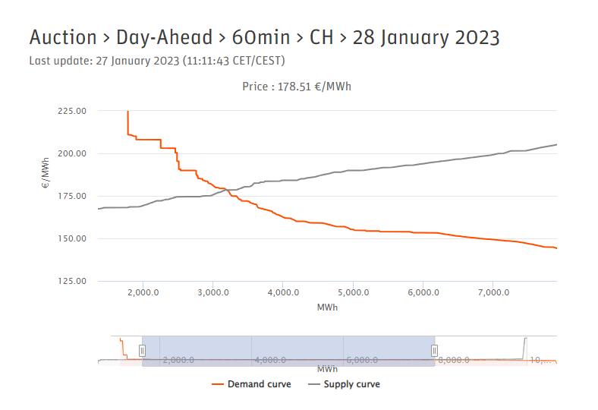
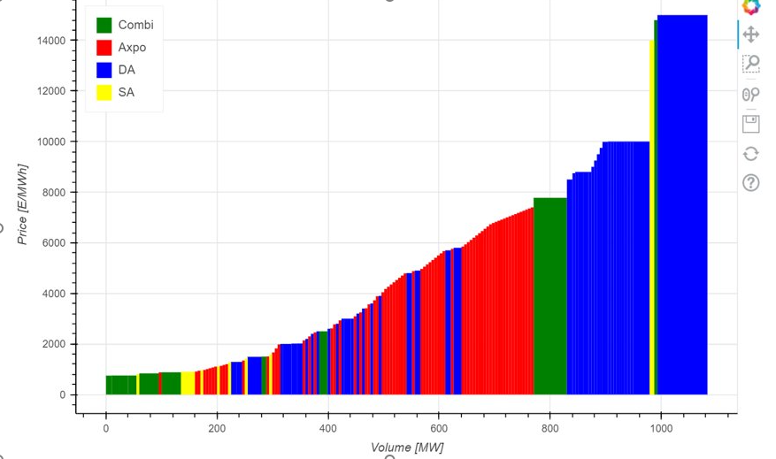
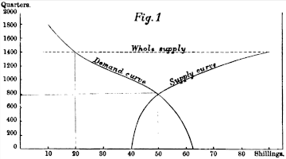
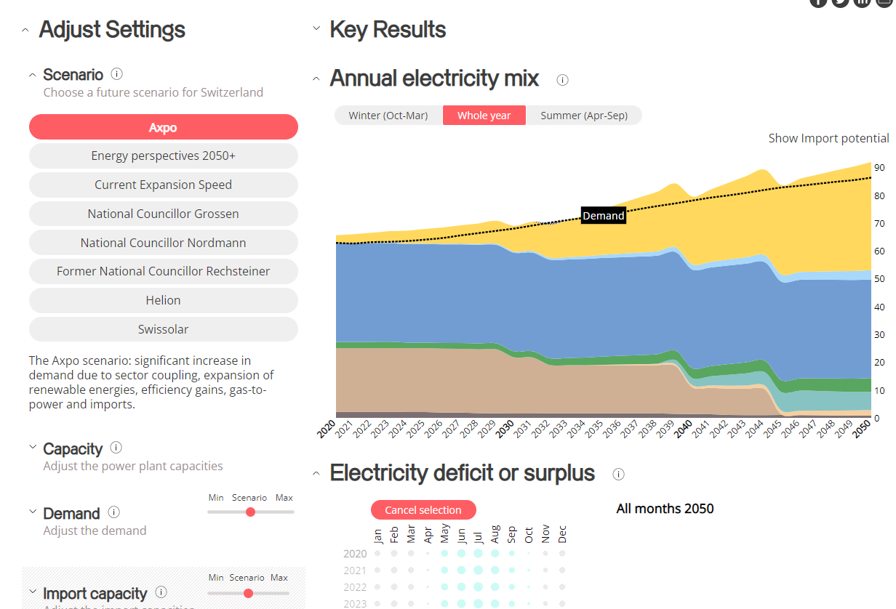

IDEAS IN A COMPLEX WORLD:-
Jenkin’s Graphical Representation (1870)
https://powerswitcher.axpo.com/
AA T&S team
EPEXSpot.com
Long term system view
Day-Ahead Market Clearing
Ancillary Services Energy Bidding
Order of Data points to process:
~100
~100’000’000
Time available for processing:
~Months
~Minutes

Slide 13




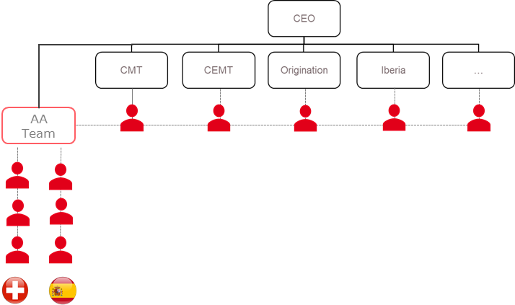
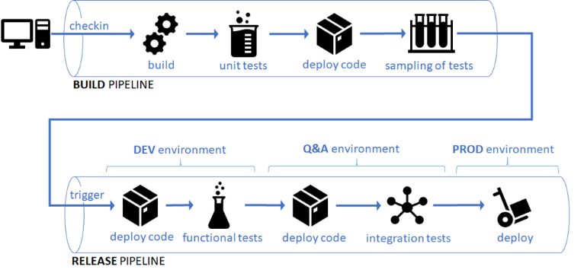
ANALYTICS AT AXPO:-
Front focus
Full stack as team
Standards
Models at core of our activity
Measure impact
On top of existing strategies
Bottom-up and hands-on
Generate profits first
Tech supports models
13 people
Data Scientists
Machine Learning Engineers
Data Engineers
Software Engineers AI/ML
Hybrid setup
Team background
CI/CD, DevOps, MLOps,..
Power Systems (PhD)
Optimization (PhD)
Telecom Engineering
Computer Science
Quant Finance
Energy Engineering

Slide 14
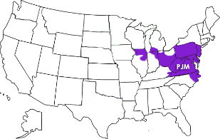
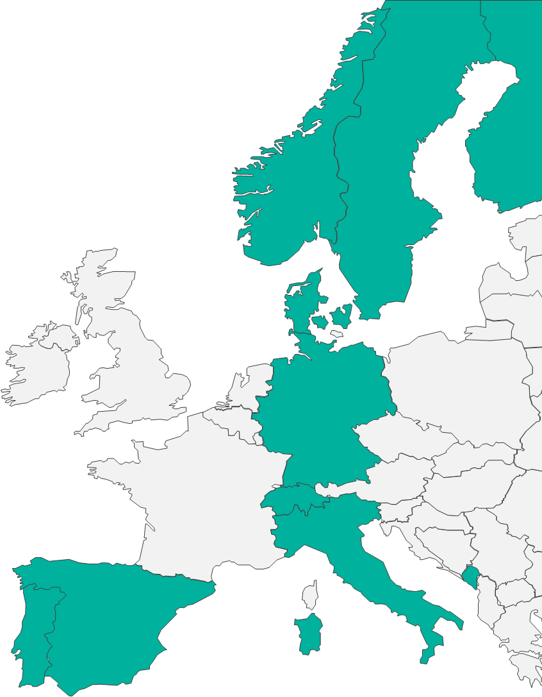
CURRENT MODELS | FACTS & FIGURES:-
~15 models (Recommendations and/or Tradeable actions)
Domains
Wind & PV
Imbalances
X-border capacities
Reserve auctions
Spot prices
Gas demand
Power demand
Markets
D-1 & ID spot
Balancing
X-Border
ID Gas
Data
Several sources per model
Forecasts, metering, realized prices
Update Master every night
Extensive feature engineering (Time-series focus)
ML Models
LightGBM
Rulefit
kNN
(N-Beats )
Further aspects
Update Master every night (~ 3 Mio rows)
Retrain daily & predict hourly
Post-processing (optimization)
Model-Serving: files, PowerBI
2nd order benefits

Slide 15
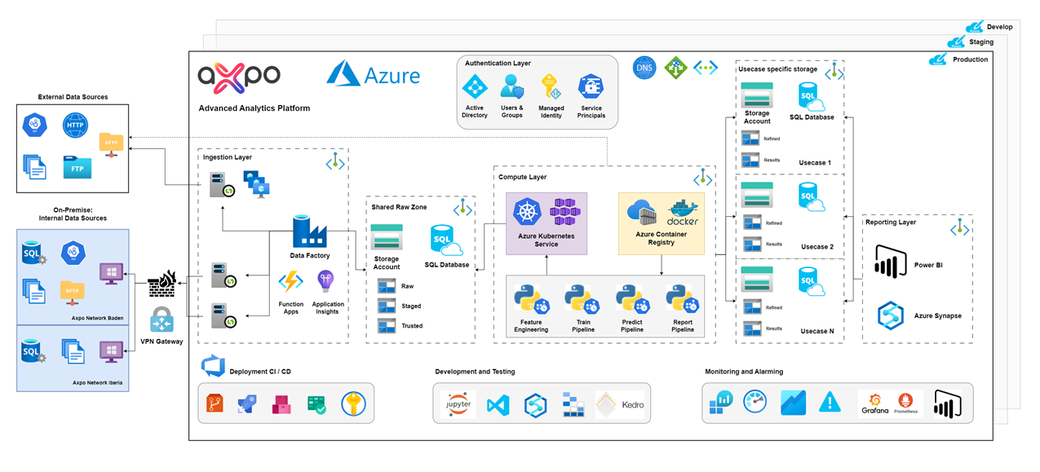
PLATFORM DESIGN:-
Report
Get Data
Compute

Slide 16
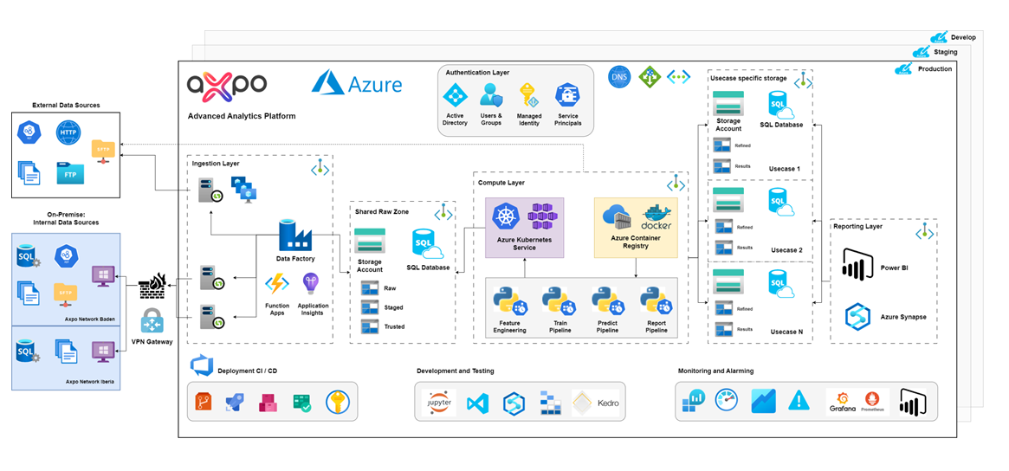
AZURE ARCHITECTURE:-

Slide 17




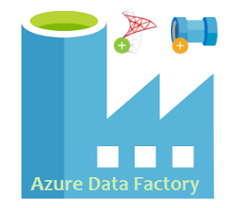



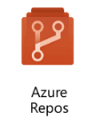

DEVOPS IN ADVANCED ANALYTICS:-
Infrastructure – Terraform and Azure Devops
Containers – Azure Kubernetes Service (AKS), Azure Container Registry (ACR) and Azure Devops
Data – Azure Data Factory (ADF) and Azure Synapse
Database – Dacpac and/or SQLCMD with Azure Devops
Machine Learning – Kedro

Slide 18
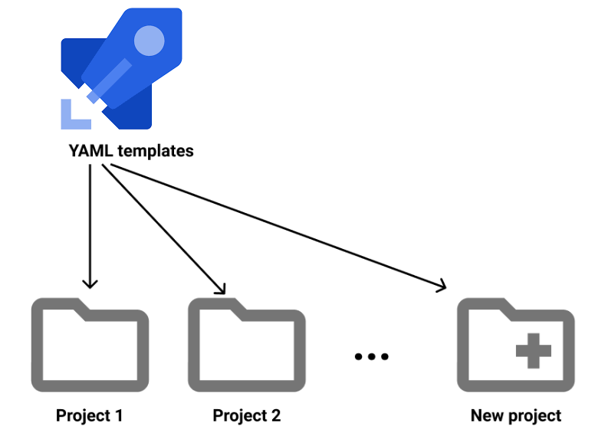
PIPELINE TEMPLATES:-
azure-pipelines-v1.0.yml
azure-pipelines-v1.0-Main.yml
azure-pipelines-v1.0-PublishPlan.yml
azure-pipelines-v1.0-Validate.yml
azure-pipelines-v1.0-Deploy.yml
Blog: https://dev.to/arindam0310018/terraform-plan-in-devops-gui-using-templates-5chp
Github: https://github.com/arindam0310018/06-July-2022-DevOps__Publish-Terraform-Plan-In-DevOps-GUI-Using-Pipeline-Templates

Slide 19
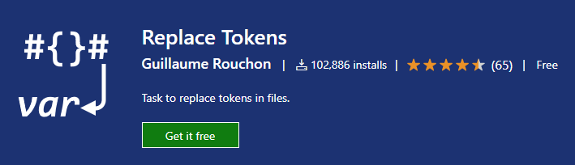
MULTIPLE ENVIRONMENT:-
Replace Token:-
https://marketplace.visualstudio.com/items?itemName=qetza.replacetokens

Slide 20
DEVOPS SSH WITH TERRAFORM MODULES:-
DEVOPS SSH:-
Pipeline Configuration (YAML) to clone Git repository from Azure Repos to the Build agent in Azure Pipelines.
Generate SSH Key Pair
Add SSH Public Key to Devops Organisation
Clone Git repository via SSH from Local System to ensure SSH works.
Add SSH Private Key to each Devops project
In Azure Pipelines, “Install SSH Key task” will download and install the SSH private key on the build agent. After successfully installing the SSH private key, on the subsequent tasks in the same job, we can use the SSH to clone the Git repository
TERRAFORM MODULES:-
Local Modules
Centralized Modules – Backend and Frontend
IaC Blueprints

Slide 21
HOW WE ONBOARD USE CASE:-
Set of similar Azure Resources
An Devops Project with specific configuration
Entitlement Management – Identity Governance – Catalog and Access Package
Blog: https://dev.to/arindam0310018/power-of-devops-cli-and-rest-api-13lo
Github: https://github.com/arindam0310018/08-Apr-2022-DevOps__Power-Of-DevOps-CLI-And-REST-API
Blog: https://dev.to/arindam0310018/setup-acr-service-connection-using-devops-2o85
Github: https://github.com/arindam0310018/10-Apr-2023-DevOps__Setup-Az-Container-Registry-Service-Connection
Blog: https://dev.to/arindam0310018/automate-entitlement-management-in-azure-ad-identity-governance-using-microsoft-graph-powershell-42k
Github: https://github.com/arindam0310018/24-Feb-2023-Microsoft-Graph-Powershell_Create-Catalog-AccessPackage-Roles-Policies

Slide 22
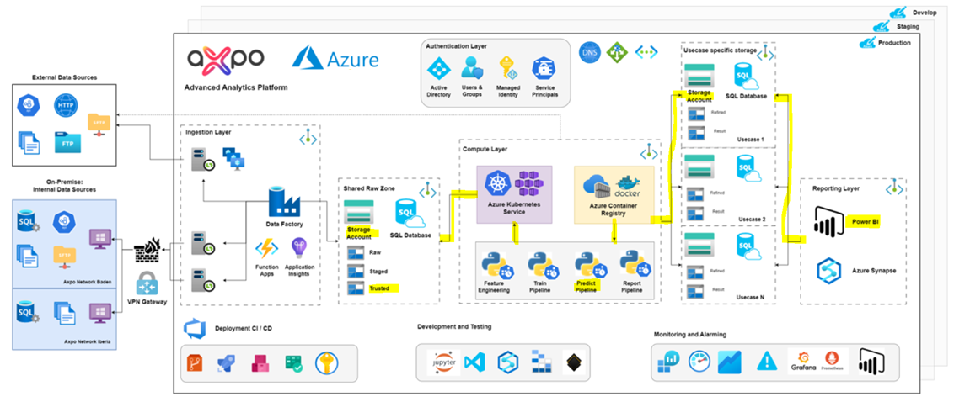
DEMO WORKFLOW:-

Slide 23
GRATITUDE:-
Our sincere Thank You to :-
Azure Bootcamp 2023 Organizers (Manuel Meyer, Stefan Johner and Stefan Roth)
Azure Bootcamp 2023 Sponsors

